Slide 1
Session 1
Introduction to
PHP Hypertext Preprocessor - PHP

Slide 2
Chapter Objectives
Client-Server Environment
What is PHP?
Compare and contrast PHP with standard HTML
Compare PHP to client-side and server-side scripting languages

Slide 3
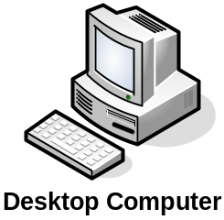
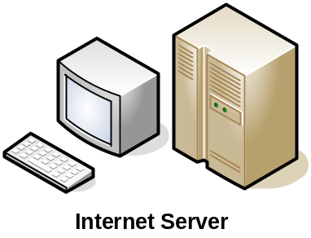
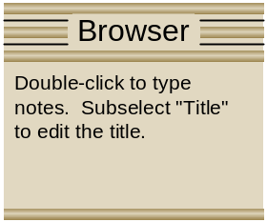
Client-Server Environment
Internet
Server receives a request for information
ISP
2
Client sends a request for information to an IP address
Client sends a request for information to an IP address
Client receives information from the server
1
4
3
I have an IP address: 020.006.023.004
I have an IP address:
199.056.787.111
Also, I can be called by my domain name:
www.mysite.com
Browser asks client computer to send requests out and interprets incoming data

Slide 4
What is PHP?
PHP is a powerful server-side scripting language for creating dynamic and interactive websites.
PHP is the widely-used, free, and efficient alternative to competitors such as Microsoft's ASP. PHP is perfectly suited for Web development and can be embedded directly into the HTML code.
The PHP syntax is very similar to Perl and C. PHP is often used together with Apache (web server) on various operating systems. It also supports ISAPI and can be used with Microsoft's IIS on Windows.

Slide 5
Why PHP?
PHP runs on different platforms (Windows, Linux, Unix, etc.)
PHP is compatible with almost all servers used today (Apache, IIS, etc.)
PHP is FREE to download from the official PHP resource: www.php.net
PHP is easy to learn and runs efficiently on the server side

Slide 6
What is a PHP File?
PHP files may contain text, HTML tags and scripts
PHP files are returned to the browser as plain HTML
PHP files have a file extension of ".php", ".php3", or ".phtml“ …

Slide 7
HTML Page Execution
You Request an HTML Page
www.hn-aptech.com/resumes.htm
Server finds and downloads the page
Browser displays the page

Slide 8
PHP Page Execution
You Request an PHP Page
www.hn-aptech.com/default.php
Server finds the page
Server executes PHP commands, converts PHP to HTML/XML as needed, processes HTML/XML
Browser displays the page

Slide 9
PHP Development Environment
Apache
Database Software
MySQL, MS SQL, ODBC …
Development Tools
  Simple: Notepad, TextPad
  Normal: FrontPage, DreamWeaver

Slide 10
PHP Installation
Download PHP for free here: http://www.php.net/downloads.php
Or Download AppServNetwork:
http://www.appservnetwork.com/
\\aptech01\Publics\PHP\Setup.exe

